Slide 1
Coatings
Custom Finishes

Slide 2
Coating Options
Steel
Aluminum
Galvanized
Liquid
Powder
Paint Over Galvanized
CorroCote
Brushed Satin
Anodized / Duranodic
Liquid
Powder
Paint Over Anodized
Paint Over Chromate

Slide 3
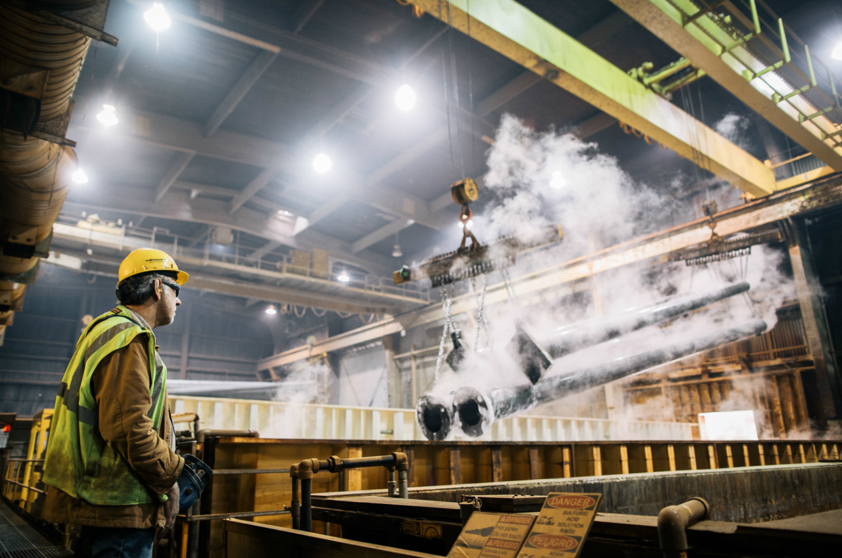
Steel – Galvanized
Apply a corrosion resistant zinc coating by dipping fabricated steel into a bath of molten zinc
Cost effective
Durable
Complete coverage inside and out
“Maintenance free” service life
Notes:
Steel exposed to the environment is continuously attacked, a process called corrosion. To prevent against this costly corrosion, protective coatings are often used. Galvanizing has been a corrosion protection method dating back as far as 1742.
Galvanizing involves cleaning steel and immersing the clean steel in a bath of molten zinc. The key component that makes galvanizing unique is the intermixing of iron from the steel and zinc from the molten bath to form the galvanized coating.
The cost of galvanizing steel is similar to other corrosion protection methods. It is a metallic coating that is more durable and abrasion resistant than other corrosion protection system. The galvanized coating provides complete, continuous coverage to all surfaces exposed in the hot-dip bath. The coating is intended to last the lifetime of the structure eliminating the maintenance cycles and providing substantial cost savings over the service life of the structure.

Slide 4
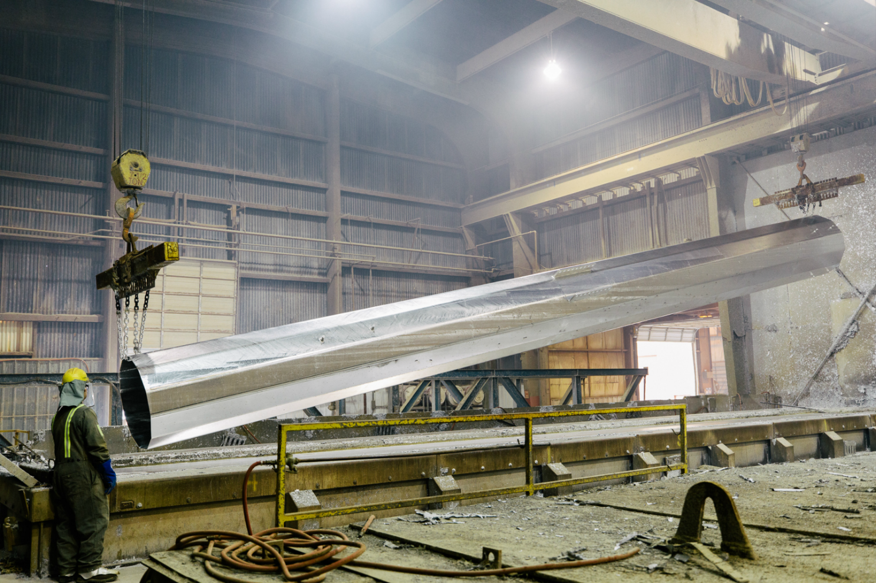
Steel – Galvanized
Galvanizing Kettle
  98% zinc
  Temperature range 820° - 860°F
  Minor allying elements
    Aluminum – Brightness
    Tin – Brightness
    Nickel – Reduce reactivity
    Bismuth – Promotes drainage
    Lead – Promotes drainage
Notes:
After the steel has been completely cleaned, it is now ready for immersion in the galvanizing kettle. The kettle contains zinc specified to ASTM B 6, which outlines the purity of zinc. Three different grades are outlined in specification ASTM B6. These grades vary in zinc purity. All of these grades contain at least 98% zinc and also include other trace elements.
Small amounts of other metals may be added to the zinc melt in order to promote certain desirable properties in the galvanized coating. Aluminum is added to the kettle to increase the brightness of the coating appearance. Nickel is sometimes added in order to reduce the reactivity of highly reactive steel. Other elements that are sometimes added to the kettle include bismuth (promotes drainage), tin (brightness, coating appearance), and lead (drainage).
The kettle is typically operated in a temperature range of 820-860 F, at which point the zinc is in the liquid state. Parts are immersed into the zinc melt at a relatively constant speed. The steel remains in the galvanizing kettle until the temperature of the steel increases to the point where zinc begins to diffuse into the steel and form the galvanized coating.
It is important to keep this dipping procedure in mind when designing for hot-dip galvanizing. Fabrications are more easily galvanized when certain design practices have been incorporated and followed. Promoting a design that allows the cleaning solutions and the molten zinc to easily flow around, in and out of the steel will facilitate a higher quality galvanized coating. Once the steel temperature has reached the reaction temperature required to form a galvanized coating, signified by a ceasing of bubbling action in the bath, the steel article is withdrawn from the zinc kettle. The entire dip usually lasts less than ten minutes depending on the thickness of the steel.

Slide 5
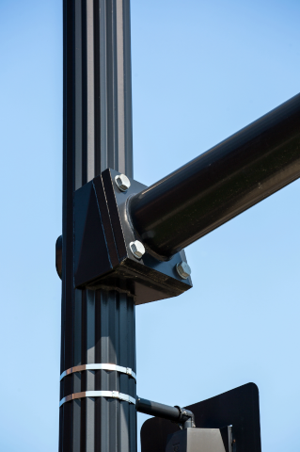
Steel – Paint Over Galvanized
Galvanized then painted
Durable
Complete galv coverage inside and out
Aesthetic differentiation
Notes:
For additional coverage and for greater street appeal, you can paint over the galvanized pole. It has the same, if not more durability and adds an aesthetic differentiation.

Slide 6
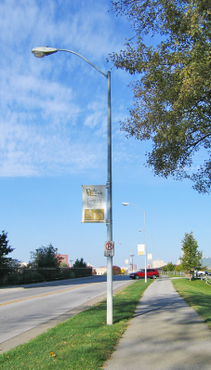
Embedded Pole Protection
Steel Poles:
  Standard – embedded section matches finish selected
  Can apply CorroCote (coal tar)to embedded portion - 6” above grade
    Advanced polyurethane coating system
    Provides an environmentally friendly barrier to corrosive soils.
  Best option would be galvanized with CorroCote
Aluminum Poles:
  Standard - embedded section coated inside and outside with gray epoxy zinc rich paint – 6” above grade
  Ask about advanced finish options if needed
Notes:
If you commonly embed poles you might be interested in CorroCote or coal tar. This is good for poles that go in soils that have proven to be corrosive. CorroCote is a polyurethane coating that gives the pole another barrier of protection. An expoxy zinc rich paint can be applied to aluminum poles for similar protection. Both methods are applied to the underground section, as well as 6” above grade.

Slide 7
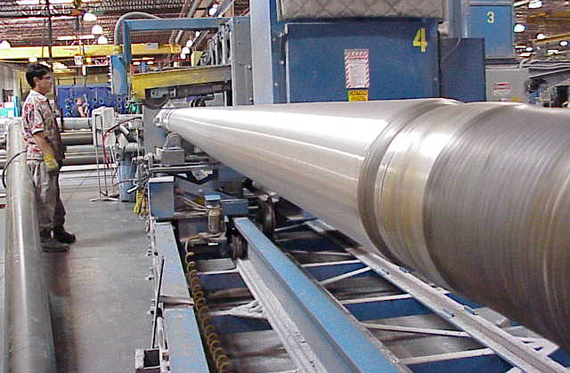
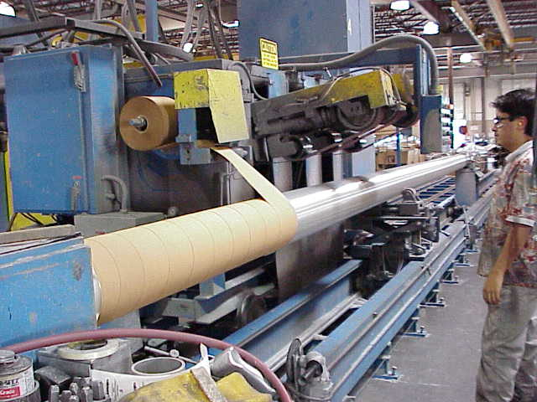
Aluminum – Brushed Satin
Unfinished aluminum surface
  Rotary spun and polished with 50-80 grit sandpaper
  This abrasive technique removes tapering marks, surface imperfections, and mill marks
    Creates a uniform surface
    Accepts paint and anodized finishes
Notes:
The standard finish for aluminum poles is brushed satin. Its polished with sandpaper to remove any imperfections and to create a uniform surface that’s good as is – or can accept paint and anodized finishes.
Polished in Farmington
Use brushed satin – you can paint or anondize for more strength

Slide 8
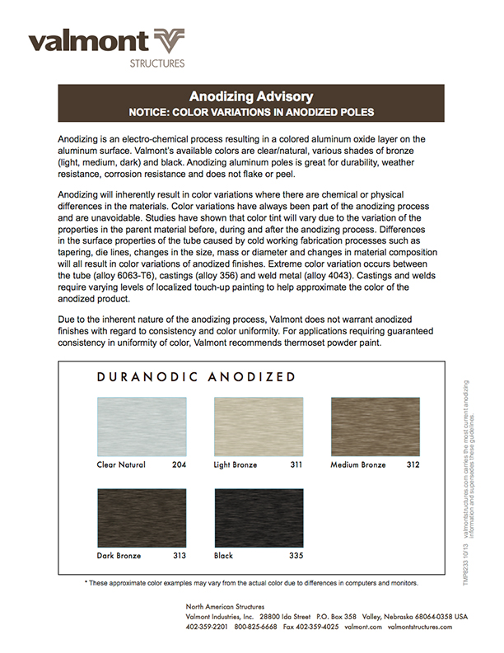
Aluminum – Anodized / Duranodic
Anodized
  Electrolytic process in an acid solution which increases the thickness of the natural oxide layer
    Increases the corrosion and wear resistance of the metal
Duranodic
  Type of anodized finish that has become the name for integral color
    Anodizing and coloring take place in a single step
Anodized / Duranodic Colors
  Clear, light bronze, medium bronze, dark bronze, and black

Slide 9
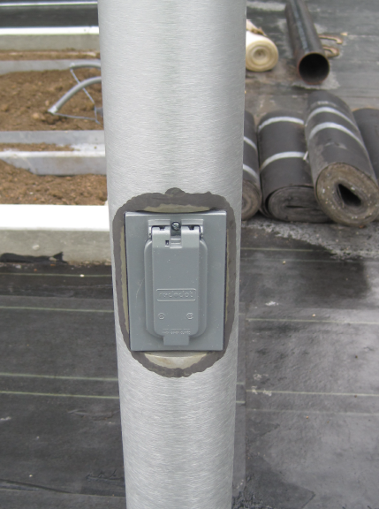
Aluminum – Anodized / Duranodic
Cautions
  Since the metal itself is changing in color, different alloys take the color differently
  Subtle tint and color differences
    Tubing
    Castings
    Welds
  These variations are unavoidable and are not defects
Notes:
Welds and portions of poles will color differently

Slide 10
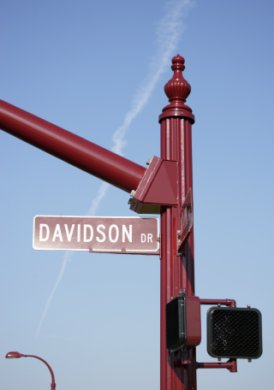
Liquid and Powder Paint – Steel & Alum.
Common reasons for liquid:
  Small orders
  Custom color match
  Architectural or specification requirement
Common reasons for powder:
  Environmental demands
  Improving material technologies
    Epoxy
    Super durables
    Pentabond
Notes:
Steel and aluminum can both be painted – and there are two types of paint that we use, liquid and powder. You can use liquid for smaller orders, if you need an exact color match, or its in the spec. Powder paint is more common and is good for environmental demands, as well as adding improving material technologies.

Slide 11
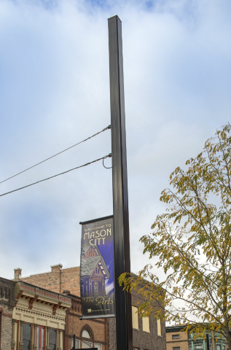
Steel – Coating Warranty
Standard Warranty = 1 year
  Finish Paint, Galvanizing, FPGV
Available extended warranties (V-PRO)
  3 year, 5 year, and 10 year
Spec Warranties
  Corrosion, Color and Gloss, Adhesion, etc.
  These characteristics will often be written in the spec
Notes:
Our standard warranty for coatings is one year. that includes paint, galvanizing, and paint over galv. There are, however, extended warranties if you’re interested.

Slide 12
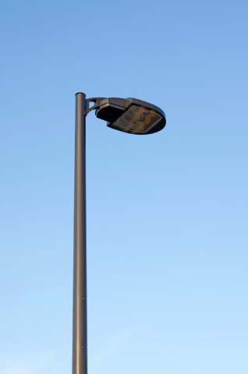
Aluminum – Paint Over Anodized
Creates a chemical surface profile for improved adhesion and seals the aluminum substrate
Compatible with liquid or powder paint
Enhanced finish process for extreme environments
  Coastal
  Industrial

Slide 13
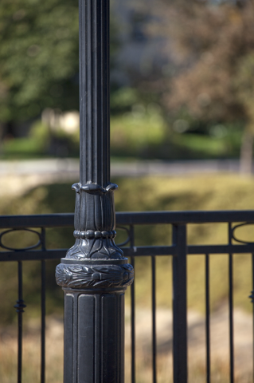
Aluminum – Paint Over Chromate
Pretreatment process for fluted and cast parts that cannot be polished
Similar to anodizing in that the aluminum is immersed in a heated bath to remove mill marks, grease, and oil related to the manufacturing process
Compatible with liquid or powder

Slide 14
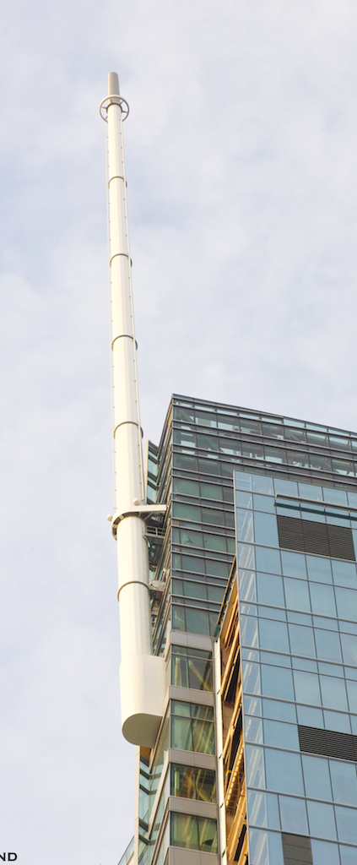
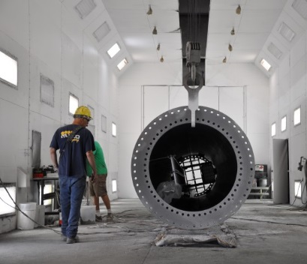
Special Paint – Wilshire Grand Hotel
Spec Requirements
  Adhesion, color and gloss, corrosion
  15 year warranty
  Tnemec Certified paint/process
Paint Selection
  3-coat liquid paint over galv
  Tnemec approved
  Multiple samples created to ensure gloss and color

Slide 15
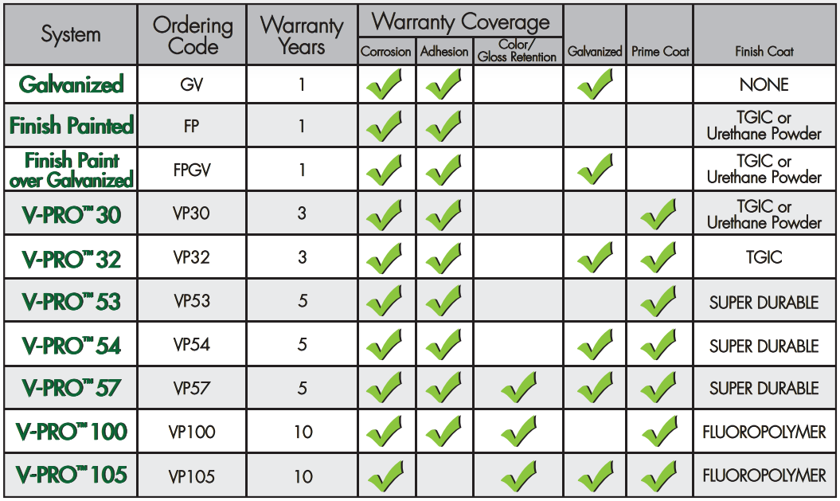
Coatings with Extended Warranties
Notes:
Don’t pick one of these – these are options.
If you want 5 yr warranty, tell PA what youre looking for and they can guide you to a spec

Slide 16
THANK YOU!
www.valmontstructures.com

